Slide 1
Prediction and analysis of rainfall
Aravind v r,21mca1023
Under the guidance of dr shyamala L

Slide 2


Slide 3
Problem statement
Analysing the existing rainfall prediction models and proposing the best model among them with better accuracy by summarising the past and current rainfall data to refrain the model.

Slide 4
Modules applied for providing an efficient result
❖ Data Selection and Loading
❖ Data Pre-processing
❖ Splitting Dataset into Train and Test Data
❖ Feature Extraction
❖ Classification
❖ Prediction
❖ Result Generation

Slide 5
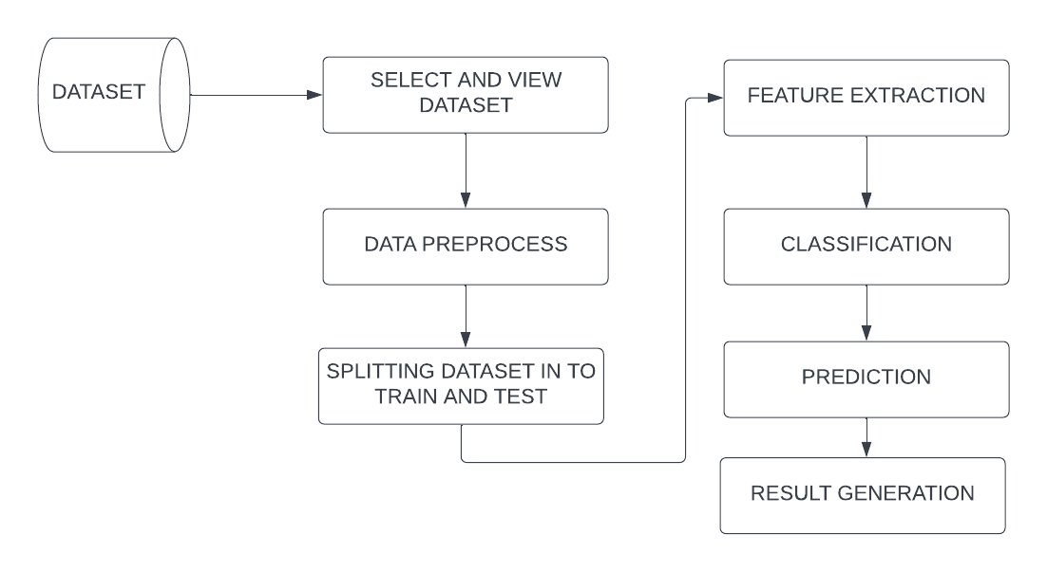
BLOCK DIAGRAM

Slide 6
Data selection and loading
In this project, the rainfall dataset is used for predicting rainfall. The dataset which contains the information about the daily data of rainfall with corresponding location.

Slide 7
DATA SET
Here taken data is rainfall of different locations in India that of csv file type

Slide 8
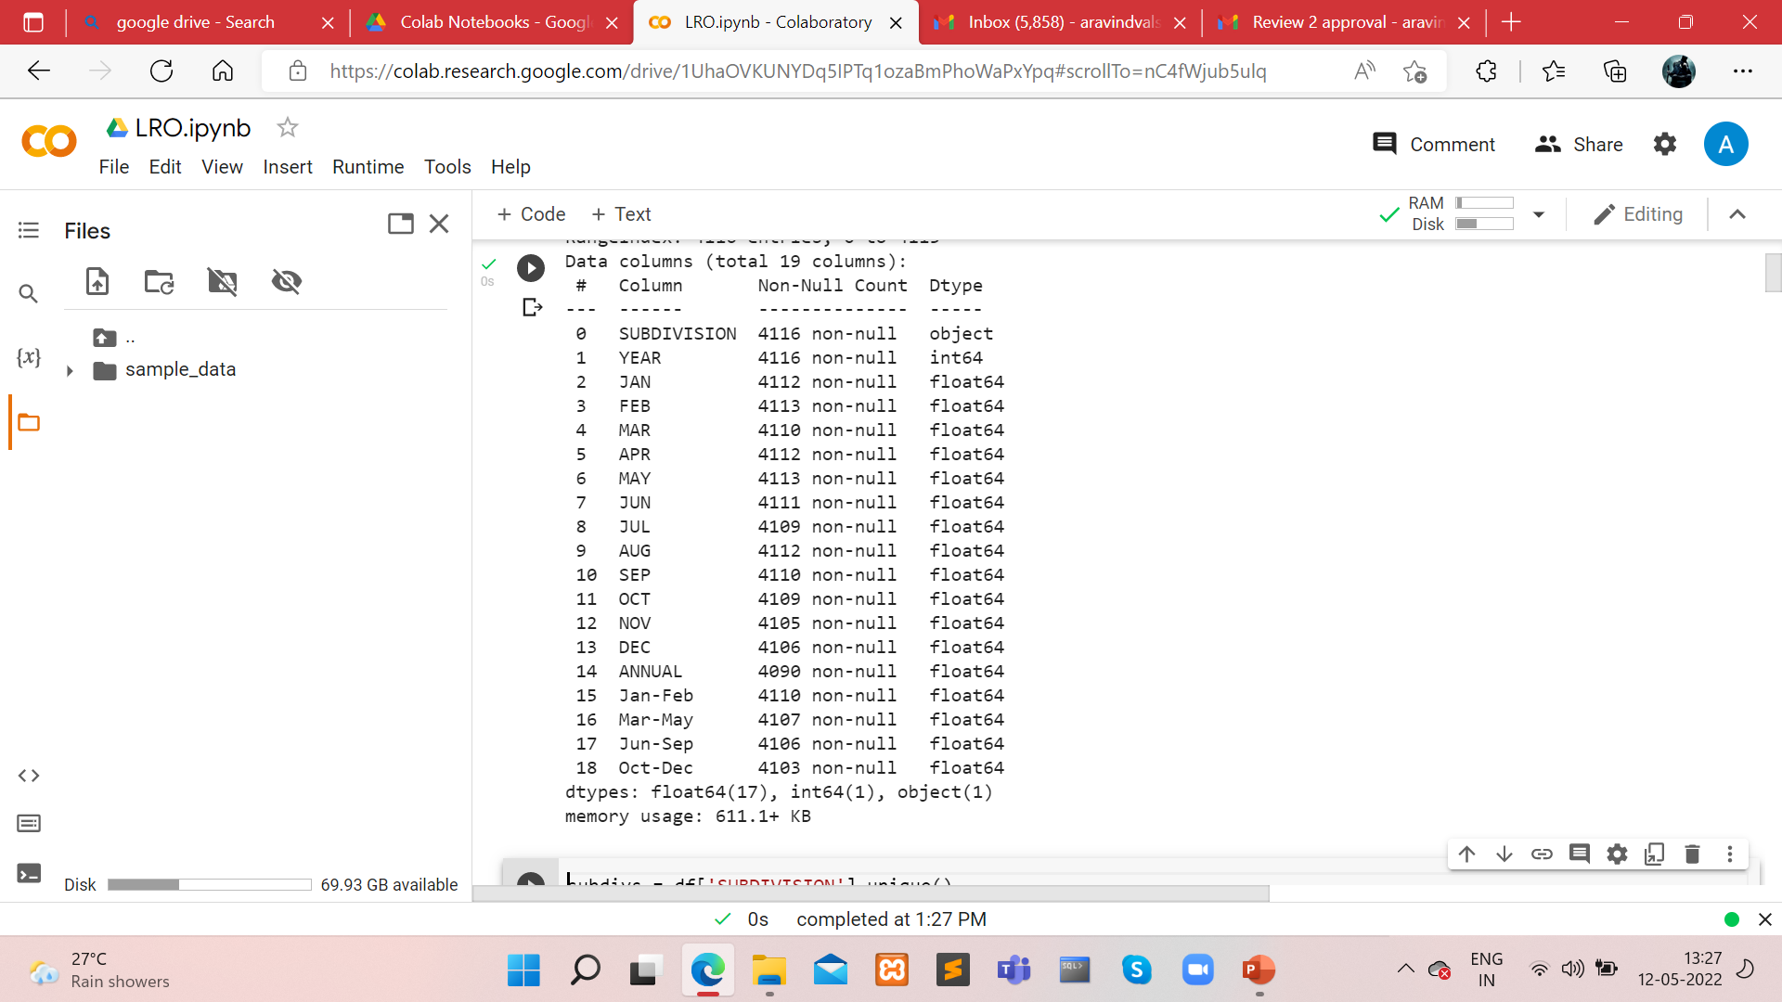

Slide 9
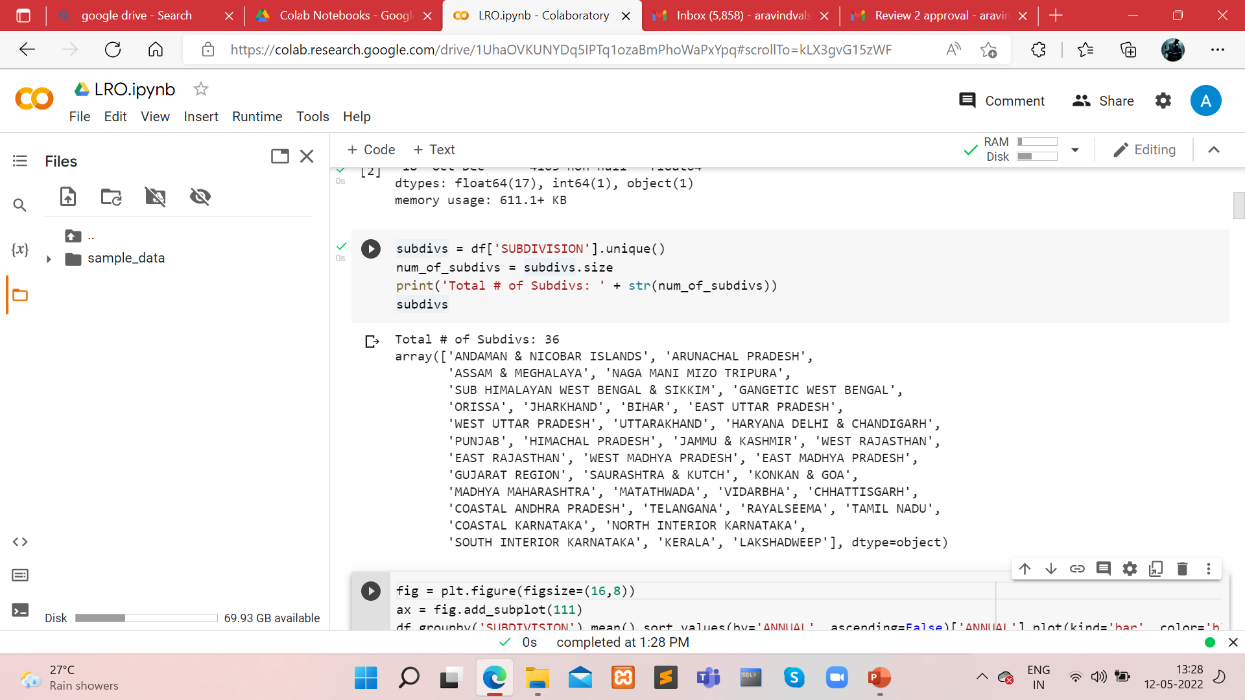

Slide 10
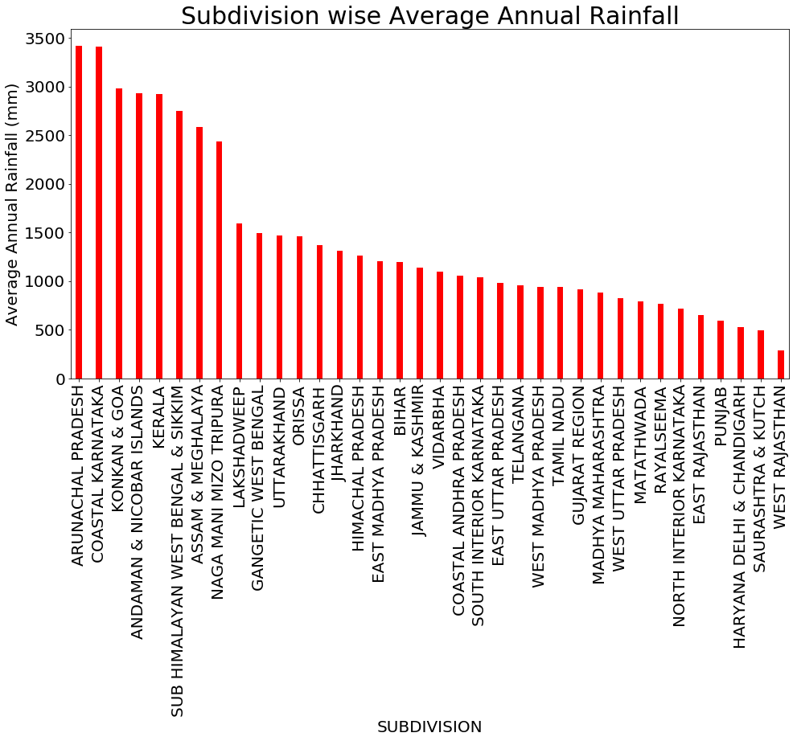

Slide 11
DATA PREPROCESSING
Data pre-processing is the process of removing the unwanted data from the dataset. o Missing data removal o Encoding Categorical data Missing data removal: In this process,the null values such as missing values are removed

Slide 12
SPLITTING DATASET INTO TRAIN AND TEST DATA
Data splitting is the act of partitioning availabledata into. Two portions, usually for cross-validators purposes. One portion ofthe data is used to develop a predictive model and the other to evaluate the model's performance.

Slide 13
FEATURE EXTRACTION
it is also known as data normalization and is generally performed during the data pre-processing step. It is a step of Data Pre Processing which is applied to independent variables or features of data. It basically helps to normalize the data within a particular range. Sometimes, it also helps in speeding up the calculations in an algorithm.

Slide 14
CLASSIFICATIOn
Classification is a process related to categorization, the process in which ideas and objects are recognized, differentiated, and understood.

Slide 15
prediction
It’s a process of predicting rainfall from the dataset. This project will effectively predict the data from dataset by enhancing the performance of the overall prediction results

Slide 16
Result generation
The Final Result will get generated based on the overall classification and prediction.The performance ofthis proposed approach is evaluated using some measures like,
❖ Accuracy
❖ Graph based on prediction

Slide 17
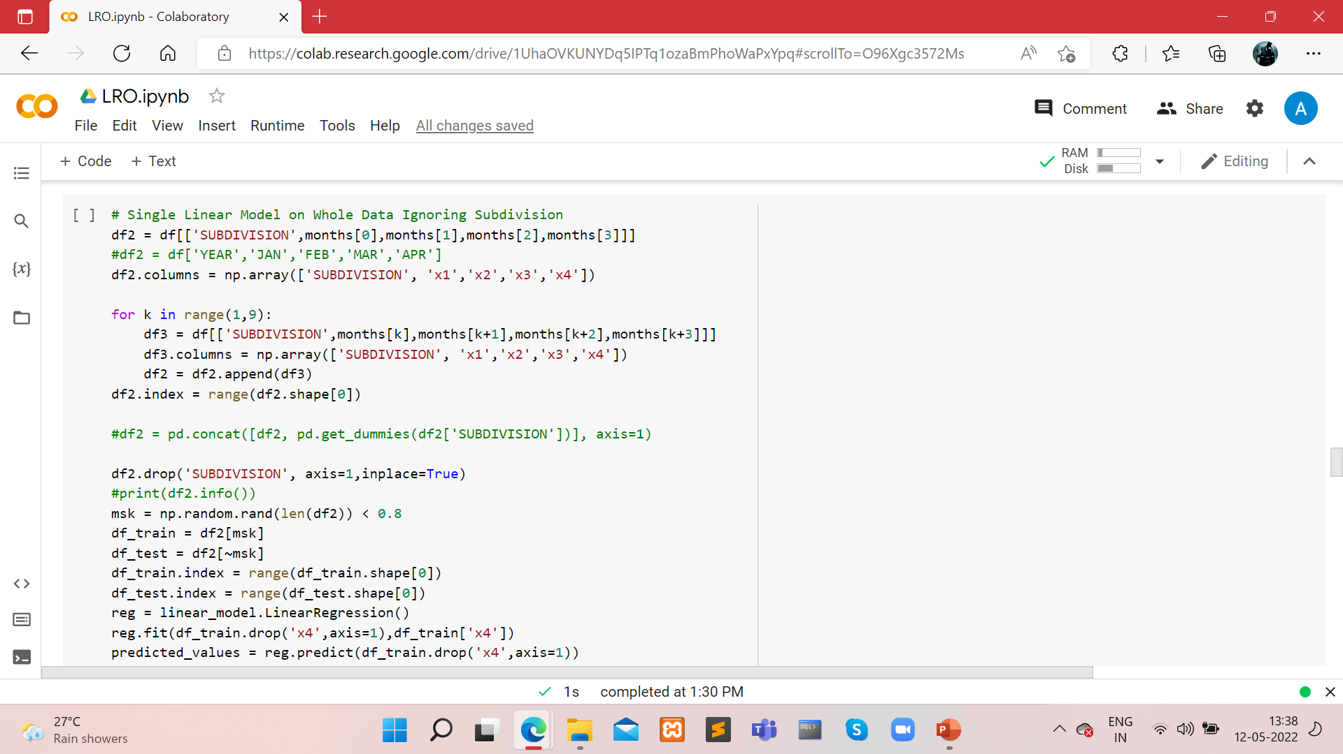

Slide 18
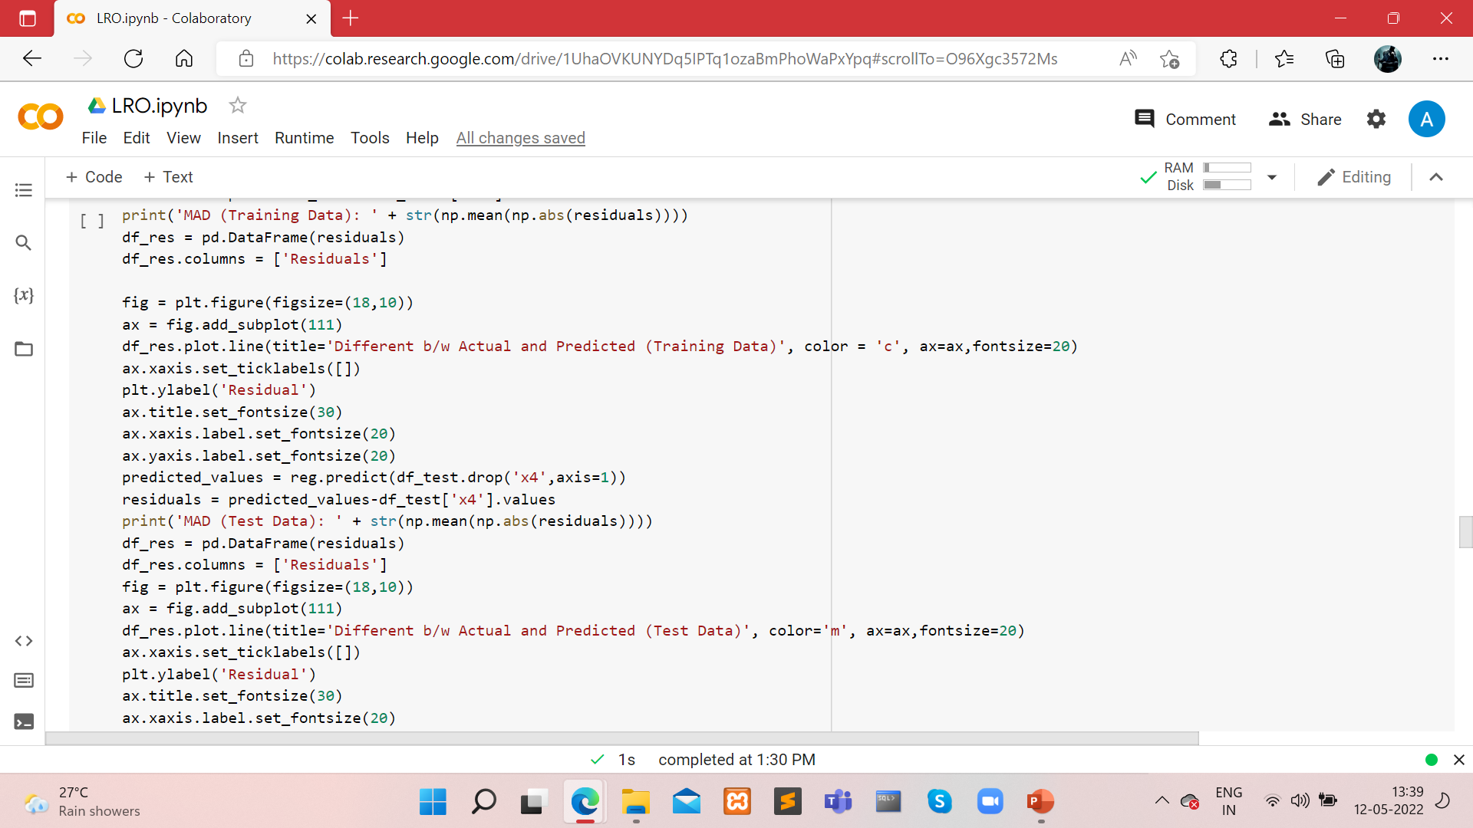

Slide 19
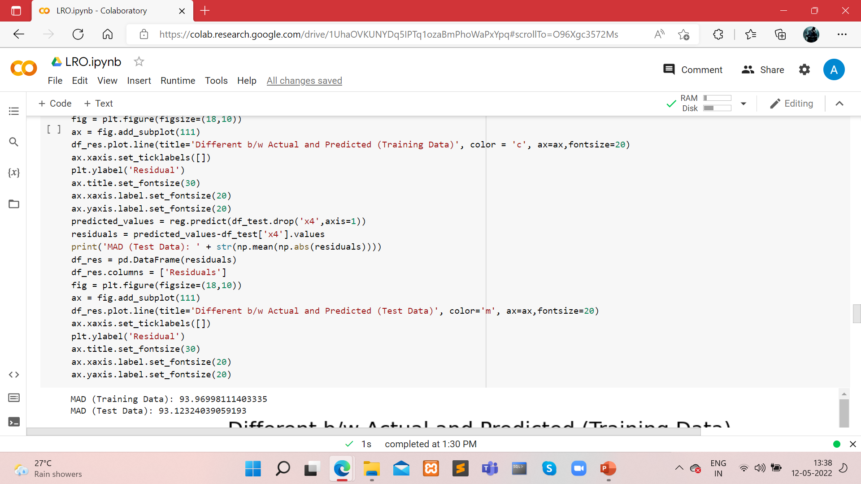

Slide 20
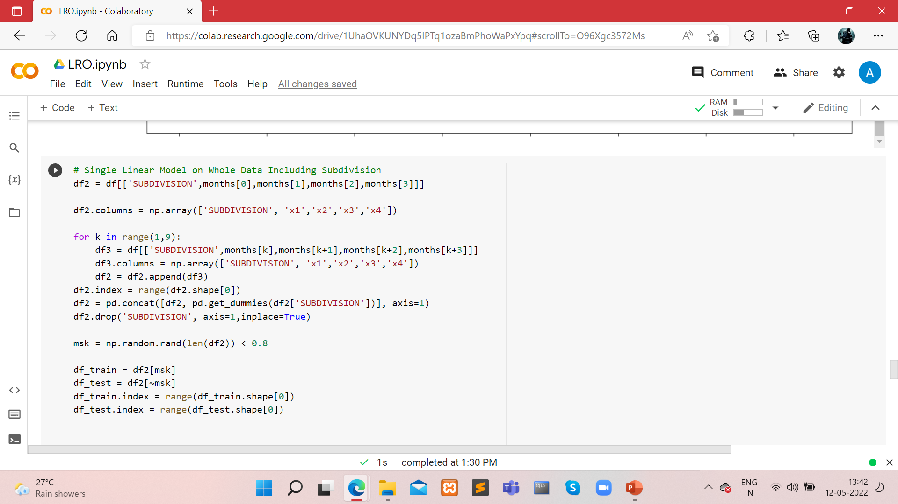

Slide 21
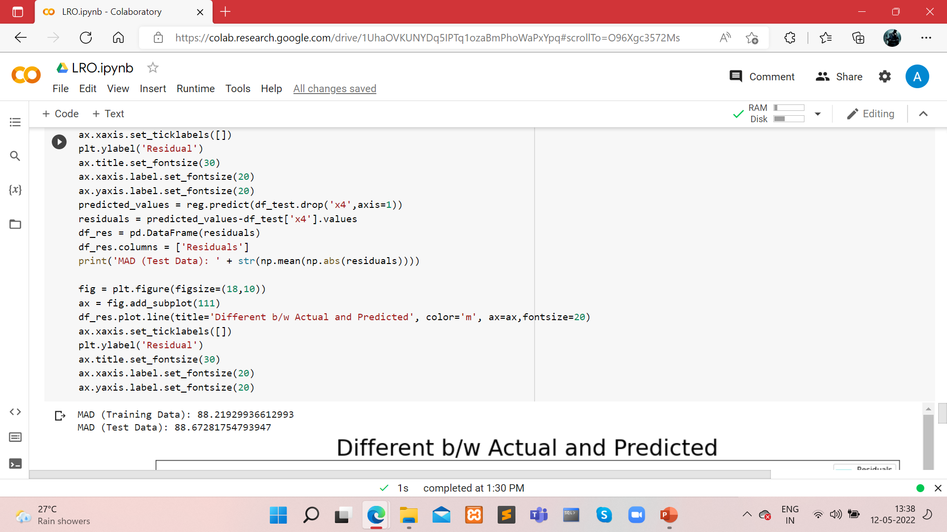

Slide 22
THANK YOU.

